Slide 1
Free Time
go in for hobbies – заниматься хобби

Slide 2
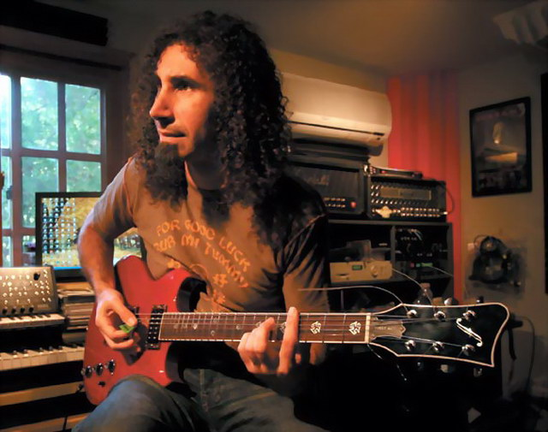
Playing musical instruments

Slide 3
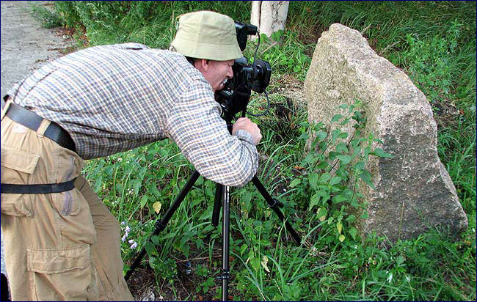
Photography
taking photos

Slide 4
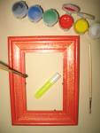

Drawing pictures

Slide 5
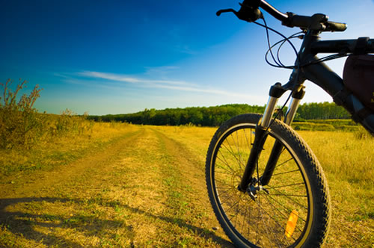
riding a bike

Slide 6
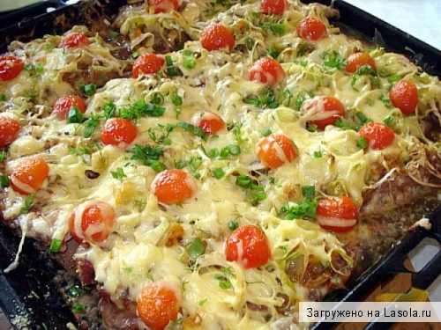
Cooking

Slide 7




Going in for sports

Slide 8
Walking

Slide 9
Dancing

Slide 10

Reading books

Slide 11
Fishing

Slide 12
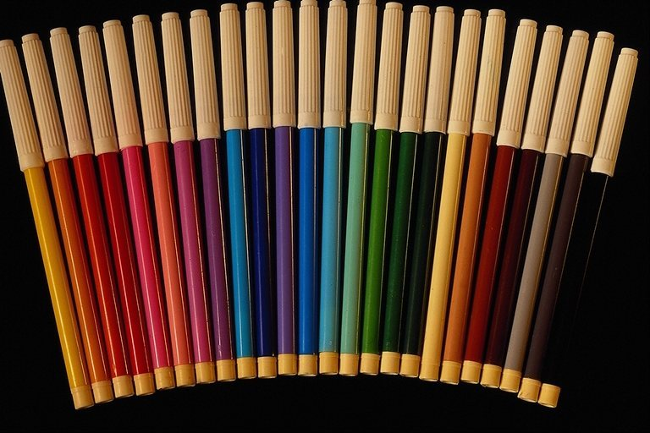
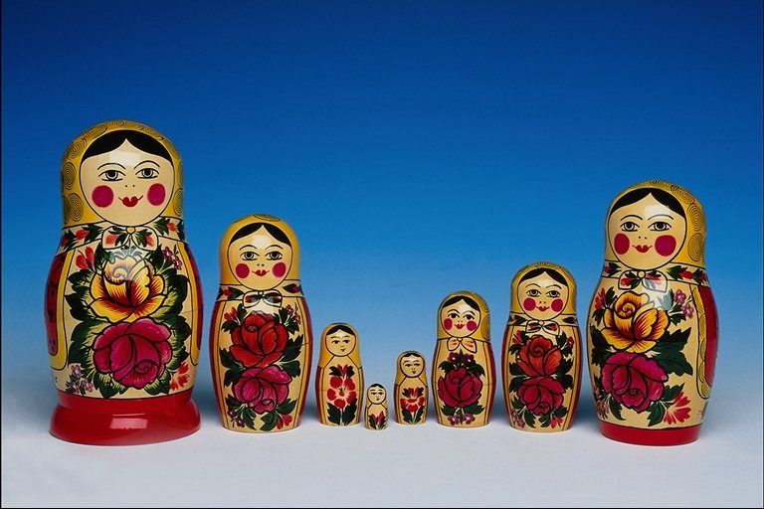
Collecting

Slide 13

Collecting

Slide 14
Put questions in 2 columns.
Does your friend collect stamps?
Is your brother interested in drawing?
Are you collecting cards and badges?
What is your mother’s hobby.
How does your family usually spend their free time?
Why do many people go in for sport?

Slide 15
Un-
happy – unhappy
fit – unfit
born – unborn
pleasant unpleasant

Slide 16
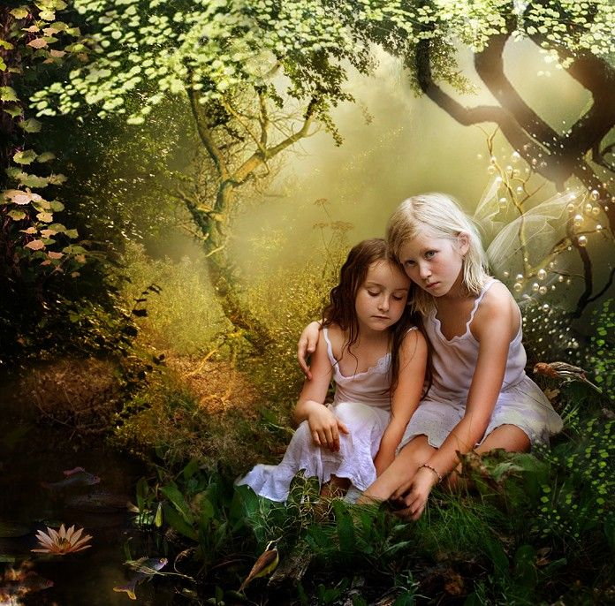
unhappy

Slide 17
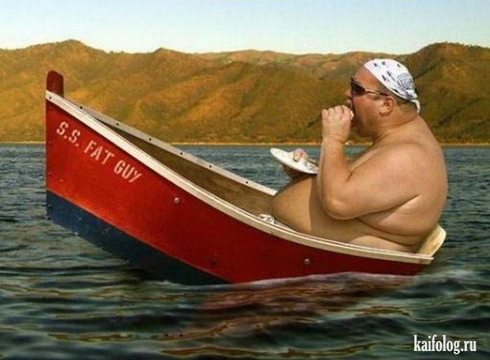
unfit

Slide 18
Homework
P. 21, ex. 7

Slide 19
Well done!
Thank you for your work!

